Slide 1
Language Basics
References:
https://www.c-sharpcorner.com
https://docs.microsoft.com
https://dotnet.microsoft.com

Slide 2
C#.NET Features
Garbage collection automatically reclaims memory occupied by unreachable unused objects.
Nullable types guard against variables that don't refer to allocated objects.
Exception handling provides a structured and extensible approach to error detection and recovery.
Lambda expressions support functional programming techniques.
Language Integrated Query (LINQ) syntax creates a common pattern for working with data from any source.

Slide 3
C#.NET Features
Language support for asynchronous operations provides syntax for building distributed systems.
C# has a unified type system.
  All C# types, including primitive types such as int and double , inherit from a single root object type.
  All types share a set of common operations.
  Values of any type can be stored, transported, and operated upon in a consistent manner.
C# emphasizes versioning to ensure programs and libraries can evolve over time in a compatible manner.

Slide 4
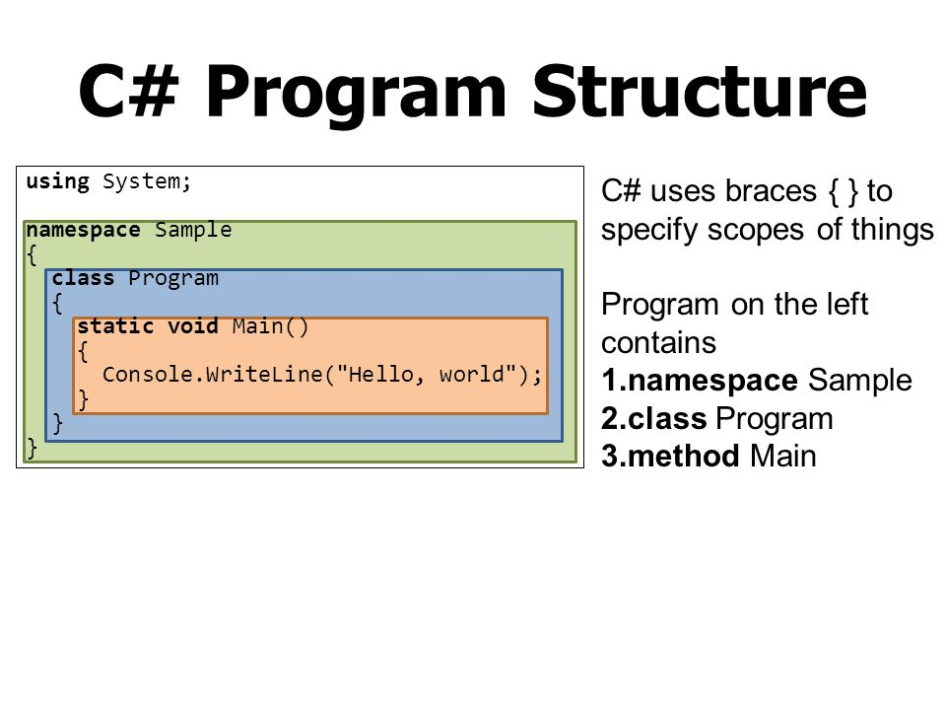
General Structure of C# Program

Slide 5
General Structure of C# Program
A C# program consists of the following parts −
  Namespace declaration
  A class
  Class methods
  Class attributes
  A Main method
  Statements and Expressions
  Comments

Slide 6
General Structure of C# Program
The using keyword is used to include the System namespace in the program.
  A program generally has multiple using statements
The next line has the namespace declaration.
  A namespace is a collection of classes
The next line has a class declaration
  the class contains the data and method definitions that your program uses
  Classes generally contain multiple methods.
  Methods define the behavior of the class.

Slide 7
General Structure of C# Program
The next line defines the Main method, which is the entry point for all C# programs
  The Main method states what the class does when executed
The Main method specifies its behavior with the statement Console.WriteLine(“ ");
  WriteLine is a method of the Console class defined in the System namespace.
  This statement causes the message to be displayed on the screen.
The last line Console.Read(); makes the program wait for a key press and it prevents the screen from running and closing quickly when the program is launched from Visual Studio .NET.

Slide 8
General Structure of C# Program
C# is case sensitive.
All statements and expression must end with a semicolon (;).
The program execution starts at the Main method.
Unlike Java, program file name could be different from the class name.

Slide 9
Data Types
The variables in C#, are categorized into the following types −
  Value types
    Value type variables can be assigned a value directly. They are derived from the class System.ValueType
  Reference types
    The reference types do not contain the actual data stored in a variable, but they contain a reference to the variables.
  Pointer types
    Pointer type variables store the memory address of another type.
    C# allows using pointer variables in a function of code block when it is marked by the unsafe modifier.
    The unsafe code or the unmanaged code is a code block that uses a pointer variable.

Slide 10
Value Types
The value types directly contain data.
Some examples are int, char, and float, which stores numbers, alphabets, and floating point numbers, respectively.
When you declare an int type, the system allocates memory to store the value.
To get the exact size of a type or a variable on a particular platform, you can use the sizeof method.
The expression sizeof(type) yields the storage size of the object or type in bytes.

Slide 11
Reference Type
Reference type refer to a memory location.
Using multiple variables, the reference types can refer to a memory location.
If the data in the memory location is changed by one of the variables, the other variable automatically reflects this change in value.
The built-in reference types are: object, dynamic, and string
The user-defined reference types are: class, interface, and delegate

Slide 12
Object type
The Object Type is the ultimate base class for all data types in C# Common Type System (CTS).
Object is an alias for System.Object class.
The object types can be assigned values of any other types, value types, reference types, predefined or user-defined types.
However, before assigning values, it needs type conversion.

Slide 13
Boxing and Un-boxing
When a value type is converted to object type, it is called boxing and on the other hand, when an object type is converted to a value type, it is called unboxing.

Slide 14
Boxing
The process of Converting a Value Type (char, int etc.) to a Reference Type(object) is called Boxing.
Boxing is implicit conversion process in which object type (super type) is used.
The Value type is always stored in Stack. The Referenced Type is stored in Heap.
For example:
int num = 23; // 23 will assigned to num
Object Obj = num; // Boxing

Slide 15
Unboxing
The process of converting reference type into the value type is known as Unboxing.
It is explicit conversion process.
For Example:
int num = 23; // value type is int and assigned value 23 Object Obj = num; // Boxing
int i = (int)Obj; // Unboxing

Slide 16
Dynamic Type
You can store any type of value in the dynamic data type variable.
Type checking for these types of variables takes place at run-time.
Syntax for declaring a dynamic type is −
dynamic <variable_name> = value;
For example,
dynamic d = 20;
Dynamic types are similar to object types except that type checking for object type variables takes place at compile time, whereas that for the dynamic type variables takes place at run time.

Slide 17
String Type
The String Type allows you to assign any string values to a variable.
The string type is an alias for the System.String class.
It is derived from object type.
The value for a string type can be assigned using string literals in two forms: quoted and @quoted.
For example,
String str = “gdcst";
A @quoted string literal looks as follows −
@“gdcst";

Slide 18
Basic UI Controls
Windows Forms controls are reusable components that encapsulate user interface functionality and are used in client side Windows applications.
Some of the basic UI controls are:
  Button
  Checkbox
  Label
  Textbox
  Combobox

Slide 19
Basic UI Controls
Button: A button is a control, which is an interactive component that enables users to communicate with an application.
The Button class inherits directly from the Button base class.
Following are few properties of button control
  Name
  Text
  Autosize
  Backcolour
  Enabled
The Click event is raised when the Button control is clicked.
Example: …

Slide 20
Timer Control
The Timer Control plays an important role in the development of programs both Client side and Server side development as well as in Windows Services.
With the Timer Control we can raise events at a specific interval of time without the interaction of another thread.
We have to use Timer Object when we want to set an interval between events, periodic checking, to start a process at a fixed time schedule, to increase or decrease the speed in an animation graphics with time schedule etc.
A Timer control does not have a visual representation and works as a component in the background.

Slide 21
Timer Control
We can control programs with Timer Control in millisecond , seconds, minutes and even in hours.
The Timer Control allows us to set Interval property in milliseconds.
By default the Enabled property of Timer Control is False.
So before running the program we have to set the Enabled property is True , then only the Timer Control starts its function.

Slide 22
Timer Control
The Timer control have included the Start and Stop methods for start and stop the Timer control functions.
Timer Tick event occurs when the specified timer interval has elapsed and the timer is enabled.
  Timer Elapsed event occurs when the interval elapses. The Elapsed event is raised if the Enabled property is true and the time interval (in milliseconds) defined by the Interval property elapses.
Timer Interval property gets or sets the time, in milliseconds, before the Tick event is raised.

Slide 23
foreach Loop
The foreach loop is used to iterate over the elements of the collection.
The collection may be an array or a list.
It executes for each element present in the array.
  It is necessary to enclose the statements of foreach loop in curly braces {}.
  Instead of declaring and initializing a loop counter variable, you declare a variable that is the same type as the base type of the array, followed by a colon, which is then followed by the array name.
  In the loop body, you can use the loop variable you created rather than using an indexed array element.

Slide 24
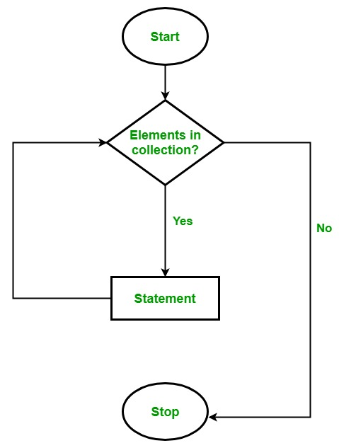
foreach Loop
Syntax:
foreach(data_type var_name in collection_variable)
{ // statements to be executed }

Slide 25
foreach Loop
Limitations of foreach loop:
  Foreach loops are not appropriate when you want to modify the array
  Foreach loops do not keep track of index. So we can not obtain array index using ForEach loop
  Foreach only iterates forward over the array in single steps

Slide 26
Windows Form Life Cycle
The events in the lifecycle of a Form from the time it is launched to the time it is closed are as follows:
  Move: This event occurs when the form is moved. Although by default, when a form is instantiated and launched, the user does not move it, yet this event is triggered before the Load event occurs.
  Load: This event occurs before a form is displayed for the first time.
  VisibleChanged: This event occurs when the Visible property value changes.
  Activated: This event occurs when the form is activated in code or by the user.
  Shown: This event occurs whenever the form is first displayed.
  Paint: This event occurs when the control is redrawn.
  Deactivate: This event occurs when the form loses focus and is not the active form.
  Closing: This event occurs when the form is closing.
  Closed: This event occurs when the form is being closed.

Slide 27
User Interface Controls
Basic Controls
  Button
  Label
  Textbox
  Checkboxes .. Etc..
Dialog controls
  OpenDialog
  SaveDialog
  FontDialog
  ColorDialog
Menu control

Slide 28
Dialog Boxes
A dialog box in C# is a type of window, which is used to enable common communication or dialog between a computer and its user.
Dialog boxes are special forms that are non-resizable.
Dialog boxes are of two types
  Modal dialog box
    A dialog box that temporarily halts the application and the user cannot continue until the dialog has been closed is called modal dialog box. For example, Message Box
  Modeless dialog box
    It is used when the requested information is not essential to continue, so the Window can be left open, while work continues somewhere else.
    For example, when working in a text editor, the user wants to find and replace a particular word.

Slide 29
Common Dialog Boxes
The dialog boxes that are used, which are common to all Windows Application.
It performs common tasks like saving a file, choosing a font etc.
The examples are given below
  OpenDialog
  SaveDialog
  FontDialog
  ColorDialog
These dialog boxes are implemented by an operating system, so they can be shared across all the Application that runs on that operating system.

Slide 30
Common Dialog Boxes
Following are steps to use common dialog box
  Instantiate the required common dialog box.
  Set the properties of common dialog box, if required.
  Call its ShowDialog() method to invoke the dialog box.
ShowDialog() returns an enumerated type called DialogResult.
It defines the identifiers, which indicates which button was clicked.
For example, DialogResult.OK and DialogResult.Cancel are some values that indicates OK or Cancel button were clicked respectively.

Slide 31
Open File Dialog Box
The OpenFileDialog allows you to choose a file to be opened in an Application.
For example, the code is given below.
  OpenFileDialog ofd = new OpenFileDialog();
  ofd.Title = "Open a Text File";
  ofd.Filter = "Text Files (*.txt) | *.txt | All Files(*.*) | *.*"; //Filter
  DialogResult dr = ofd.ShowDialog();
  if (dr == DialogResult.OK)
  {
  StreamReader sr = new StreamReader(ofd.FileName);
  txtEx.Text = sr.ReadToEnd();
  sr.Close();
  }

Slide 32
Save File Dialog Box
The SaveFileDialog box is used to allow the user to select the destination and name of the file to be saved.
For example, the code is given below.
  SaveFileDialog sfdlg = new SaveFileDialog();
  sfdlg.Filter = "Text Files (*.txt) | *.txt"; //Filter
  if (sfdlg.ShowDialog() == DialogResult.OK)
  {
  // Code
  }

Slide 33
Font and Color Dialog Boxes
FontDialogBox is used to allow the user to select font settings.
The ColorDialogBox is used to allow the user to select a color.
For example, the code is given below.
  //Font Dialog
  FontDialog fdlg = new FontDialog();
  fdlg.ShowDialog();
  txtEx.Font = fdlg.Font;
  //Color Dialog
  ColorDialog cdlg = new ColorDialog();
  cdlg.ShowDialog();
  txtEx.ForeColor = cdlg.color;

